Slide 1
NAT Rules
The NAT rules feature lets you create access rules that define how Cloud NAT is used to connect to the internet. NAT rules support source NAT based on destination address.
When you configure a NAT gateway without NAT rules, the VMs using that NAT gateway use the same set of NAT IP addresses to reach all internet addresses. If you need more control over packets that pass through Cloud NAT, you can add NAT rules.
A NAT rule defines a match condition and a corresponding action. After you specify NAT rules, each packet is matched with each NAT rule. If a packet matches the condition set in a rule, then the action corresponding to that match occurs.

Slide 2
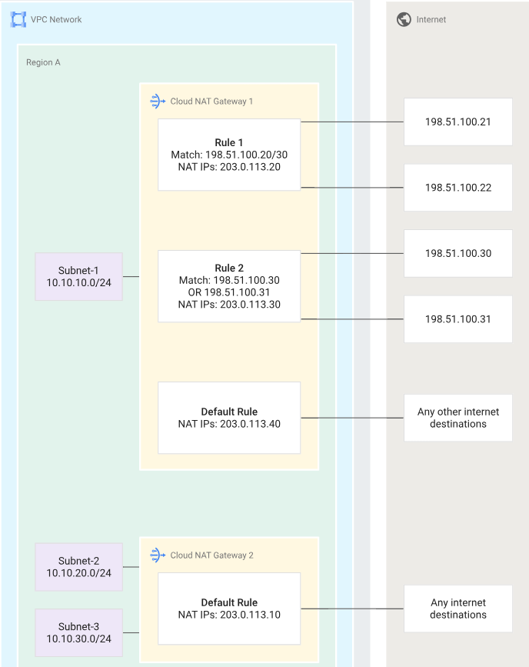
Example
Public NAT lets Google Cloud resources that do not have public IP addresses communicate with the internet. These VMs use a set of shared public IP addresses to connect to the internet.
Public NAT does not rely on proxy VMs. Instead, a Public NATgateway allocates a set of external IP addresses and source ports to each VM that uses the gateway to create outbound connections to the internet. Cloud NAT provides NAT for the following Google Cloud resources:

Slide 3
NAT rules specifications
A rule number uniquely identifies a NAT rule. No two rules can have the same rule number.
Each NAT configuration has a default rule
Cloud NAT rules are supported only when the value of the NAT IP allocate option is MANUAL_ONLY.
All IP addresses configured in a given rule must be of the same tier.
Destination IP CIDR ranges in the match condition must not overlap across NAT rules. There can be at most one rule that can match any given packet.
NAT IP addresses across NAT rules must not overlap.
NAT rules cannot be added to a NAT gateway that has Endpoint-Independent Mapping enabled.

